Slide 1
M.Ed.
MASTER OF EDUCATION

Slide 2
UNIVERSITY
M.Ed course is under ACHARYA NAGARJUNA UNIVERSITY(A.P) Guntur

Slide 3
APPROVAL
Acharya Nagarjuna University(State Govt. University) is a NACC A grade university ,approved by UGC & NCTE & equivalent to Govt. of Odisha.

Slide 4
ELIGIBILITY Candidates who passed B.Ed & having 2 years experience as a teacher or administrator in any educational institute after getting B.Ed degree.

Slide 5
COURSE DETAIL DURATION -2 YEARS (04 SEMESTERS)

Slide 6
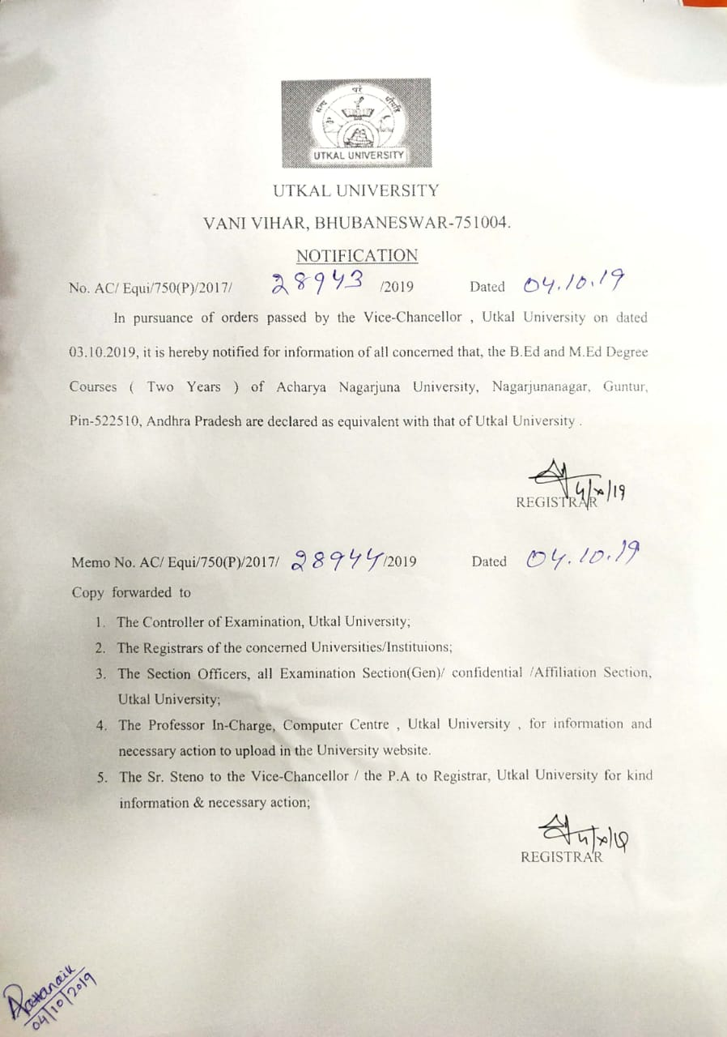
EQUIVALENCY LETTER (UTKAL UNIVERSITY)

