Slide 1
MASTER OF ARTS(M.A.-JMC)
IN
JOURNALISM & MASS COMMUNICATION

Slide 2
ELIGIBILITY
GRADUATION OR Equivalent
DUARATION
2YEARS (YEARLY EXAMINATION)

Slide 3
UNIVERSITY
M.A-JMC course is under SWAMI VIVEKANANADA SUBHARTI UNIVESRSITY approved by UGC & DEB

Slide 4
SAMPLE MARKSHEET & HALL TICKET

Slide 5
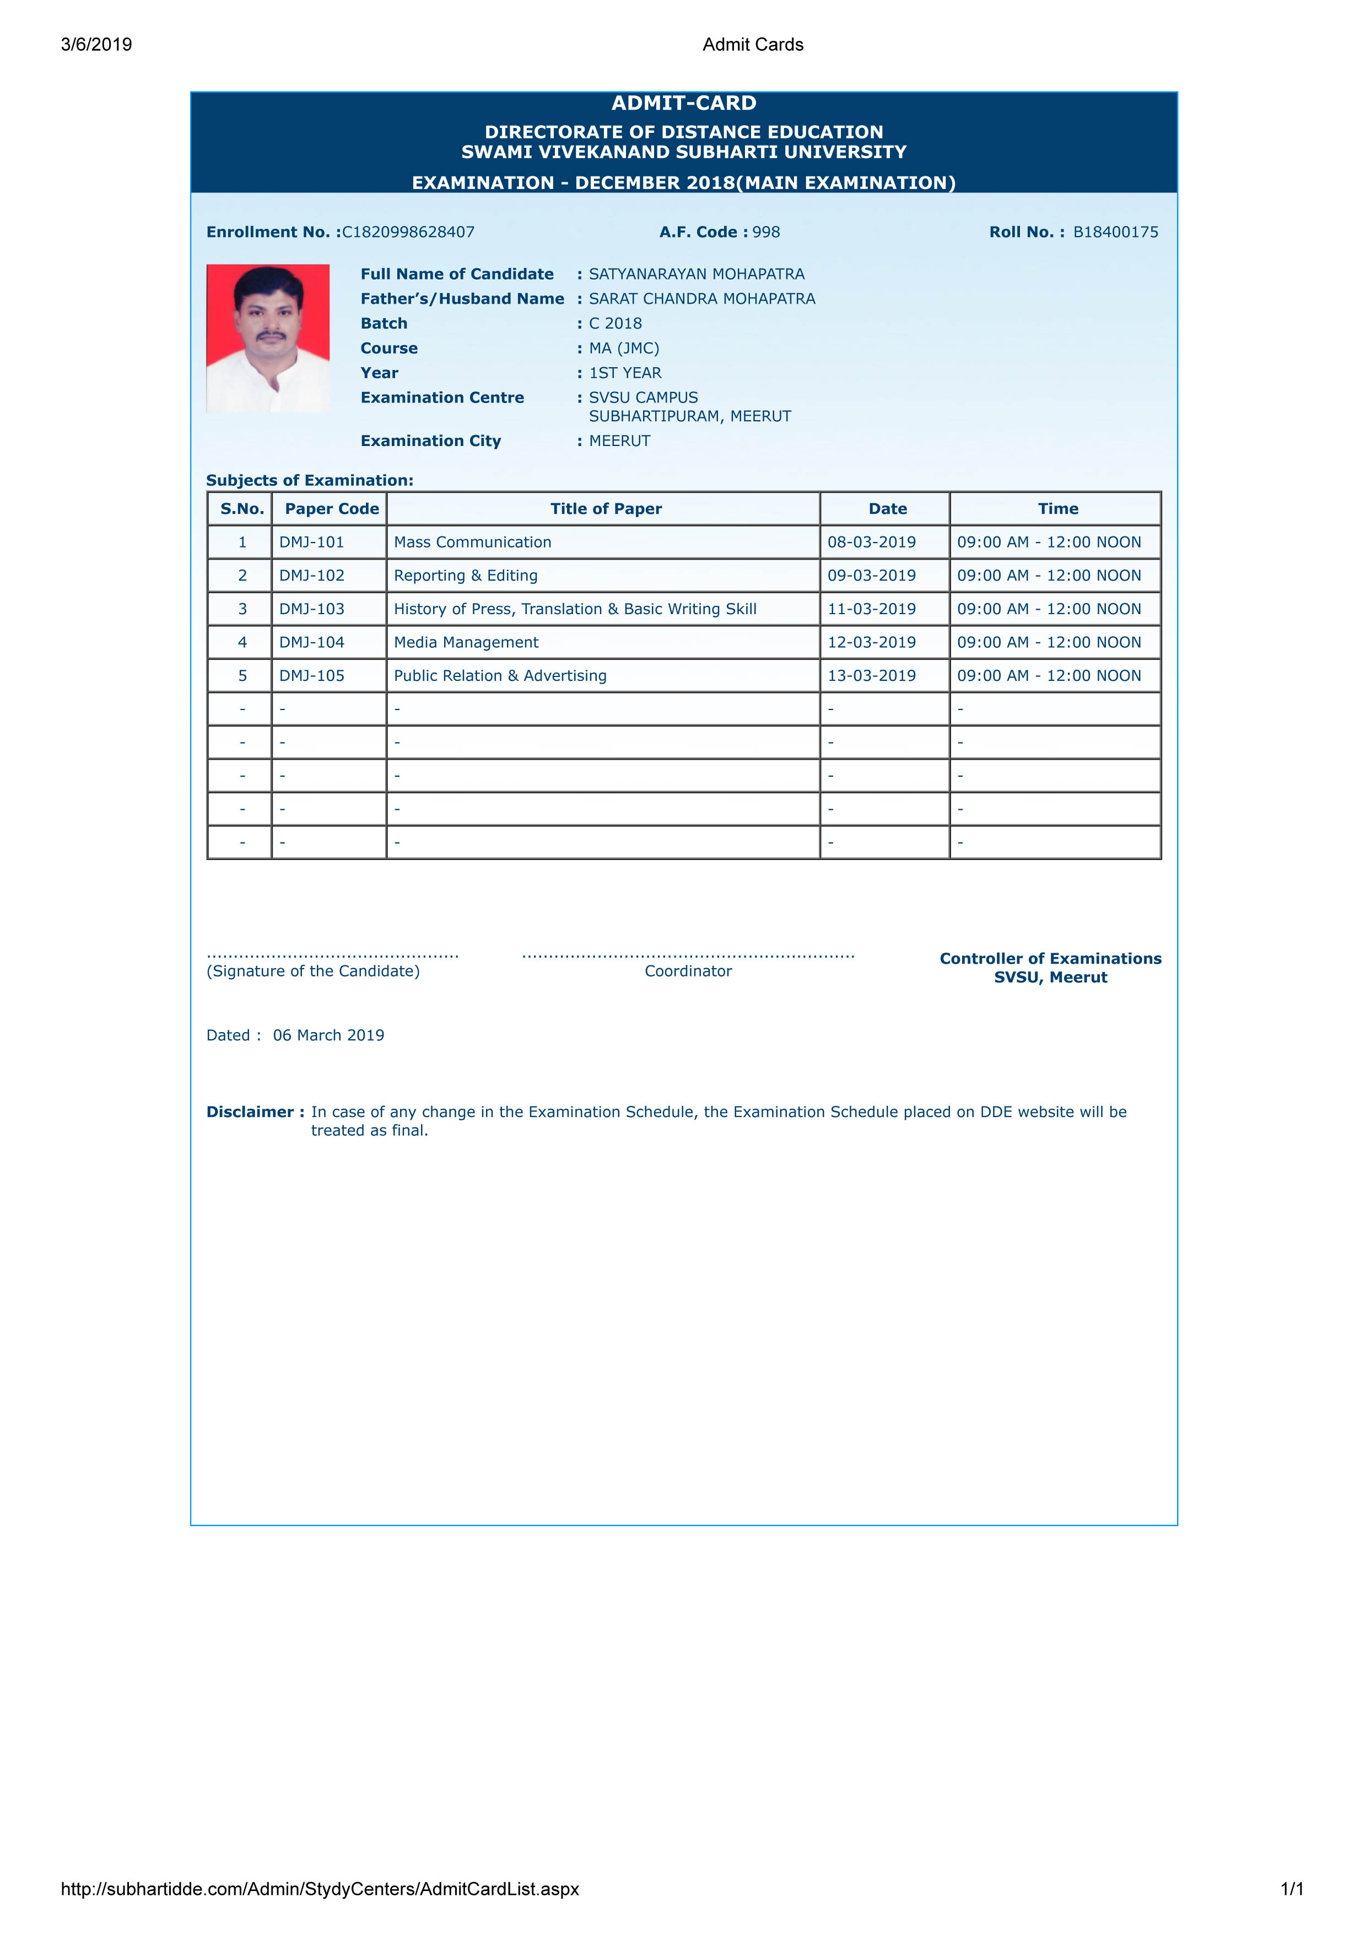
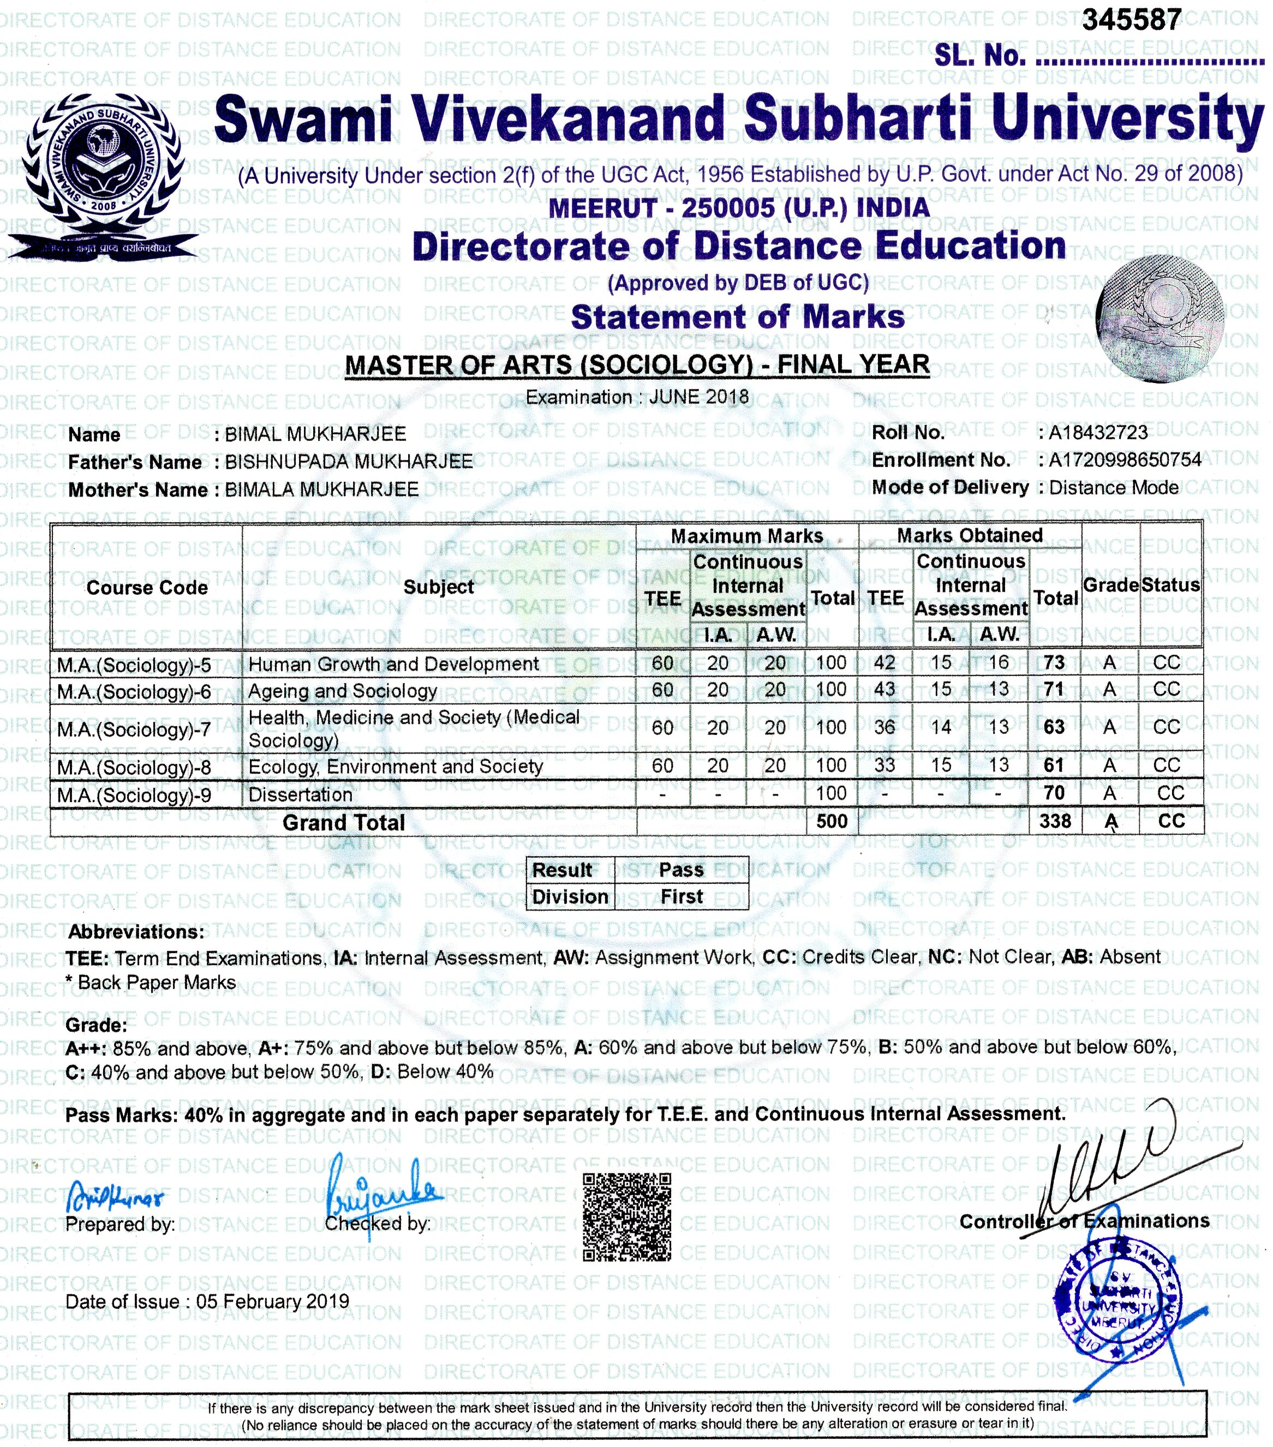
SAMPLE HALL TICKET & MARKSHEET

