Slide 1
B.Ed.
BACHELOR OF EDUCATION

Slide 2
UNIVERSITY
B.Ed course is under ACHARYA NAGARJUNA UNIVERSITY(A.P)

Slide 3
APPROVAL
Acharya Nagarjuna University(State Govt. University) is a NACC A grade university ,approved by UGC & NCTE & equivalent to Govt. of Odisha.

Slide 4
ELIGIBILITY
--50% IN AGGREGATE IN GRADUATION OR EQUIVALENT(FOR GENERAL CANDIDATES)
--45% IN AGGREGATE IN GRADUATION OR EQUIVALENT(FOR OBC CANDIDATES)
--40% IN AGGREGATE IN GRADUATION OR EQUIVALENT(FOR ST/SC CANDIDATES)

Slide 5
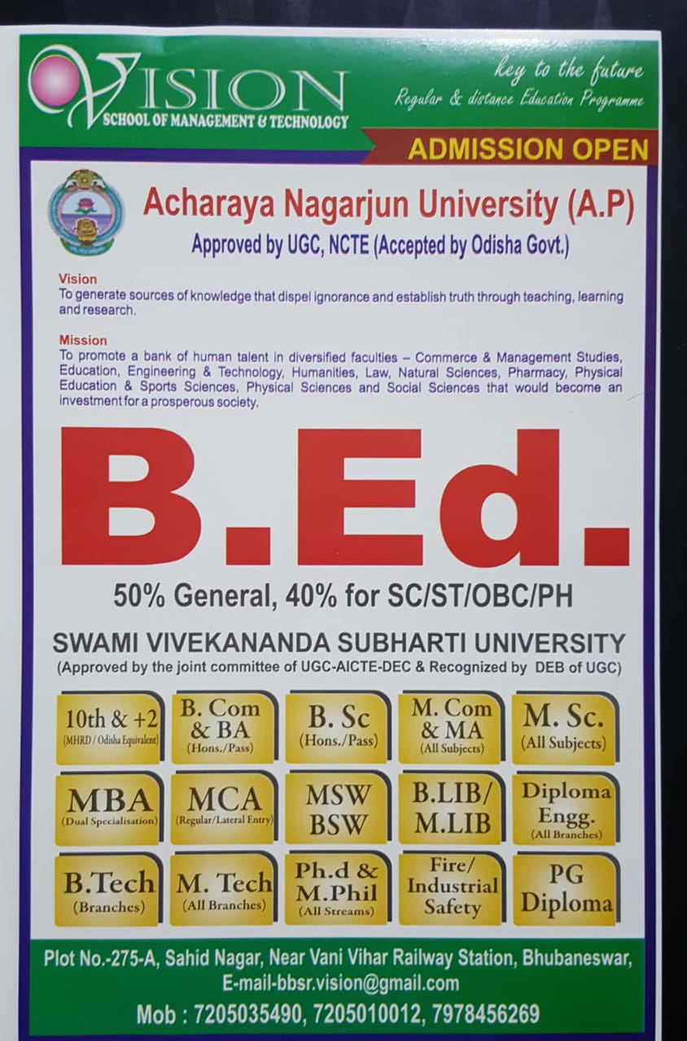
COURSE INFORMATION

Slide 6
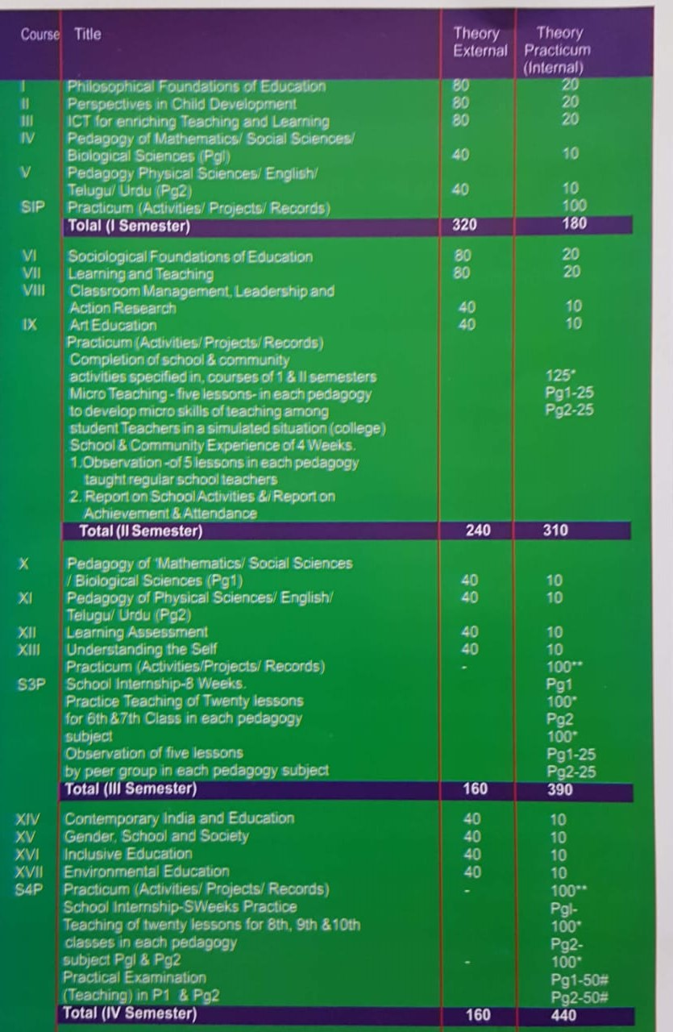
B.Ed. COURSE CONTENTS
(semesterwise)

Slide 7
COURSE DETAIL
DURATION -2 YEARS (04 SEMESTERS)
TOTAL MARKS- 2200
THEORY MARKS—880
OTHER MARKS – 1320
(Other marks include practical,internal,teaching)

Slide 8
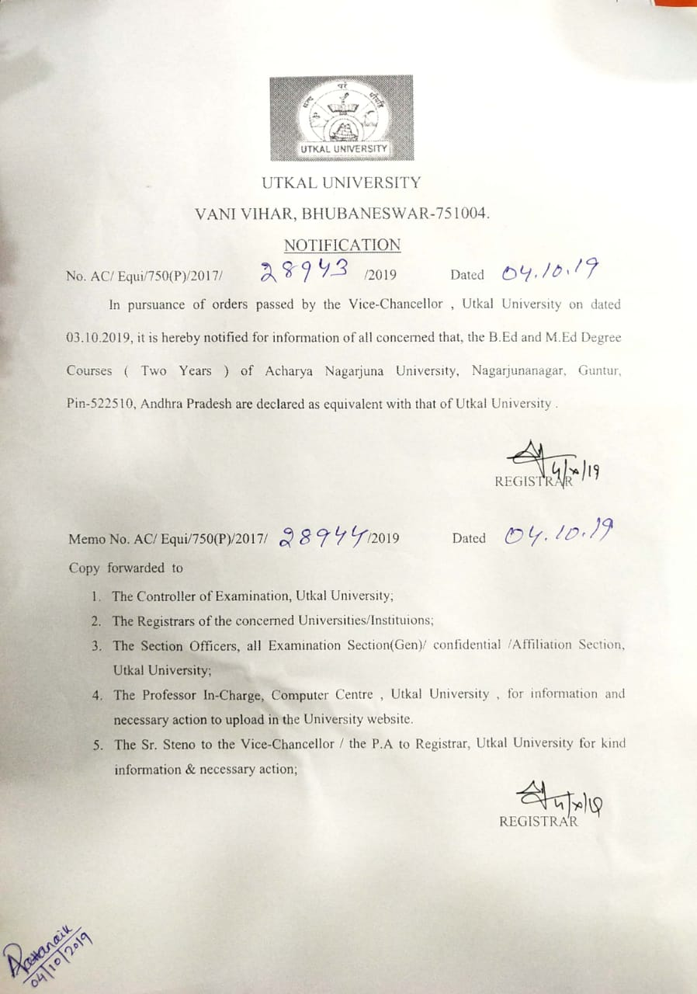
EQUIVALENCY LETTER (UTKAL UNIVERSITY)

Slide 9
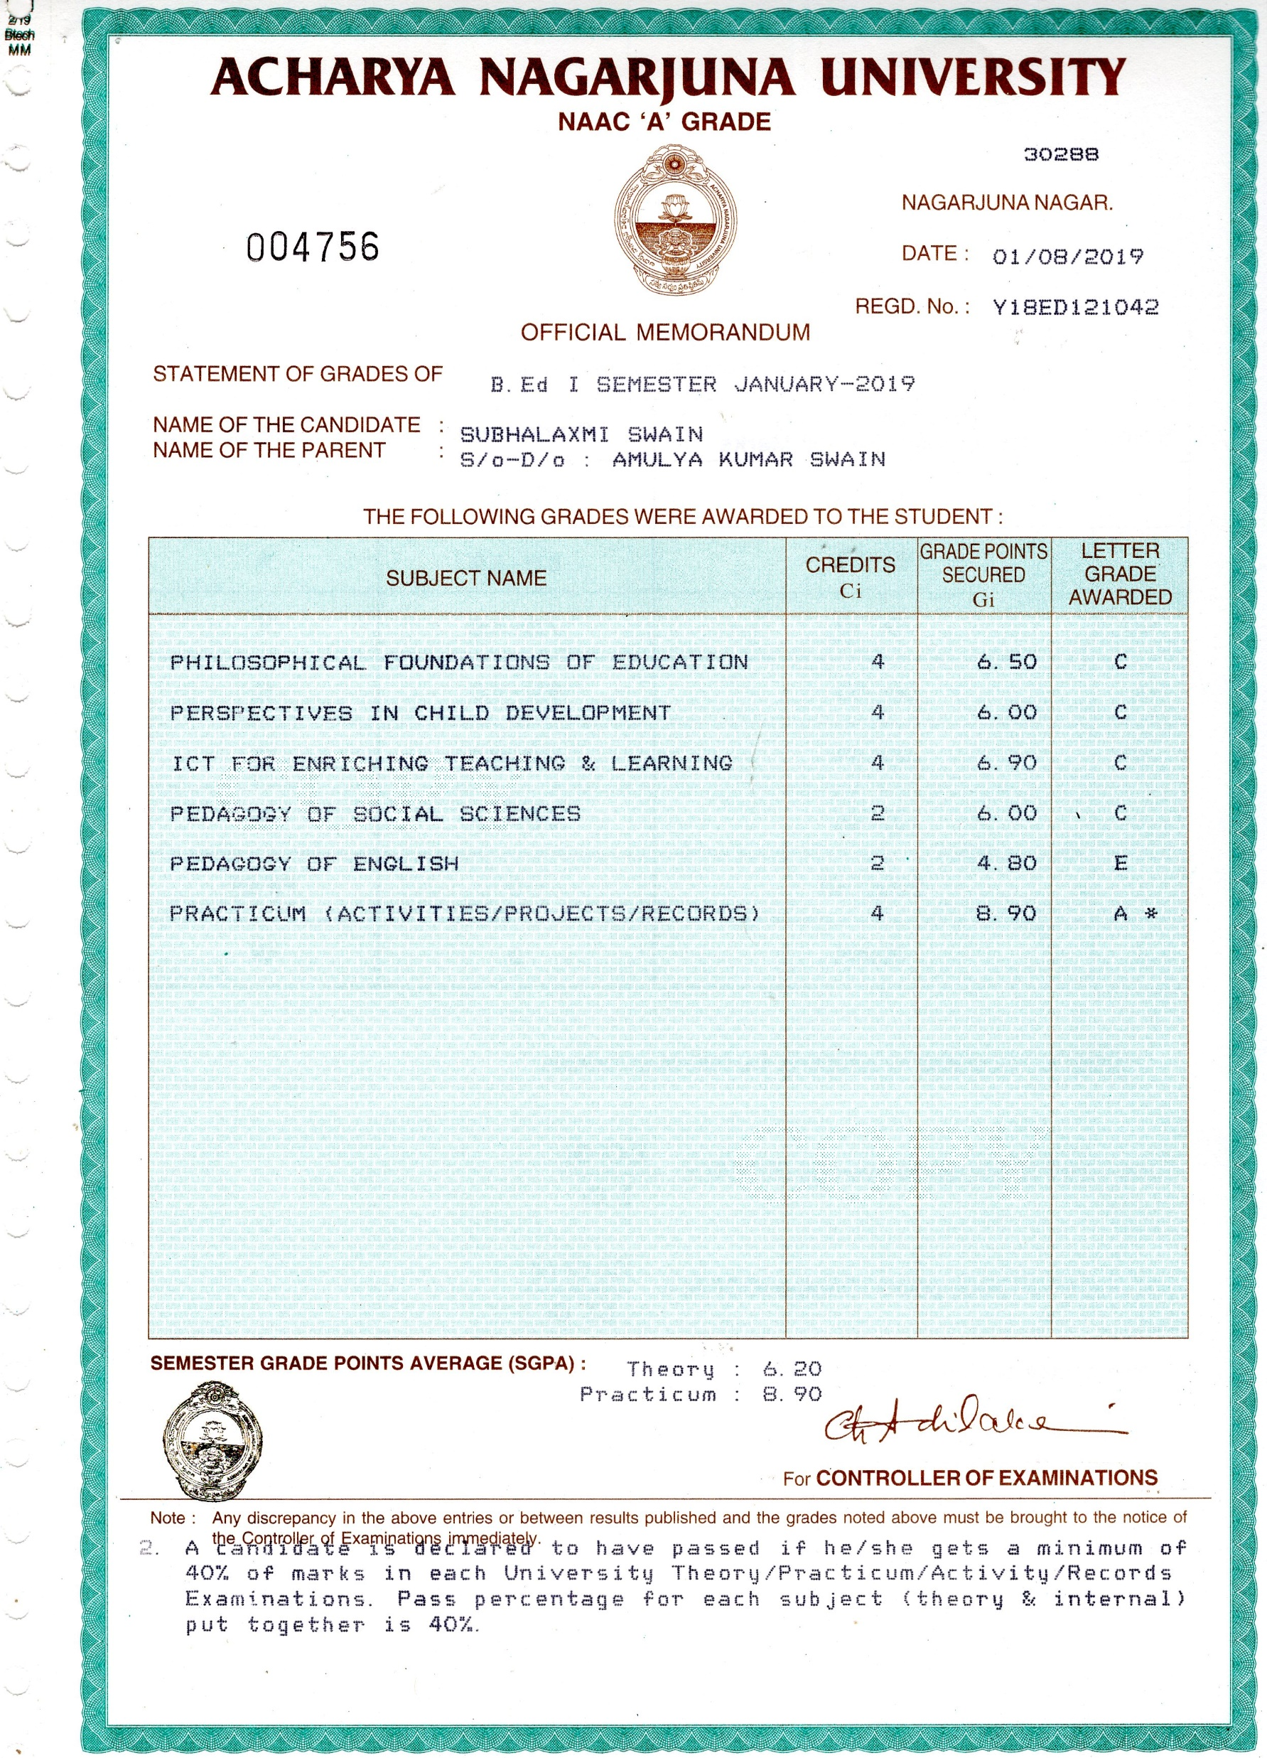
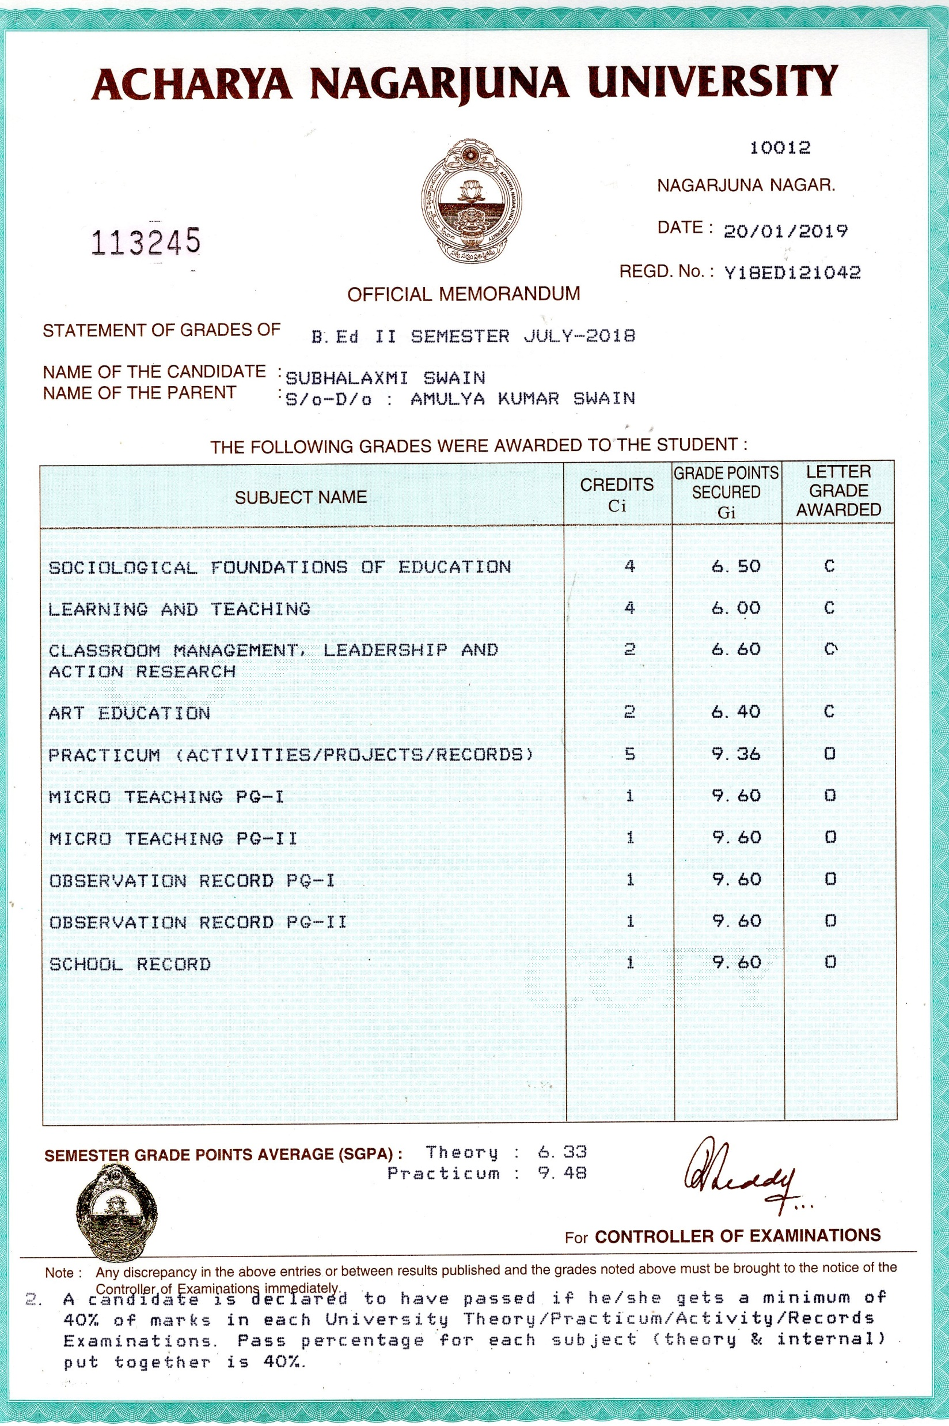
1st and 2nd Semester B.E d marksheets

Slide 10
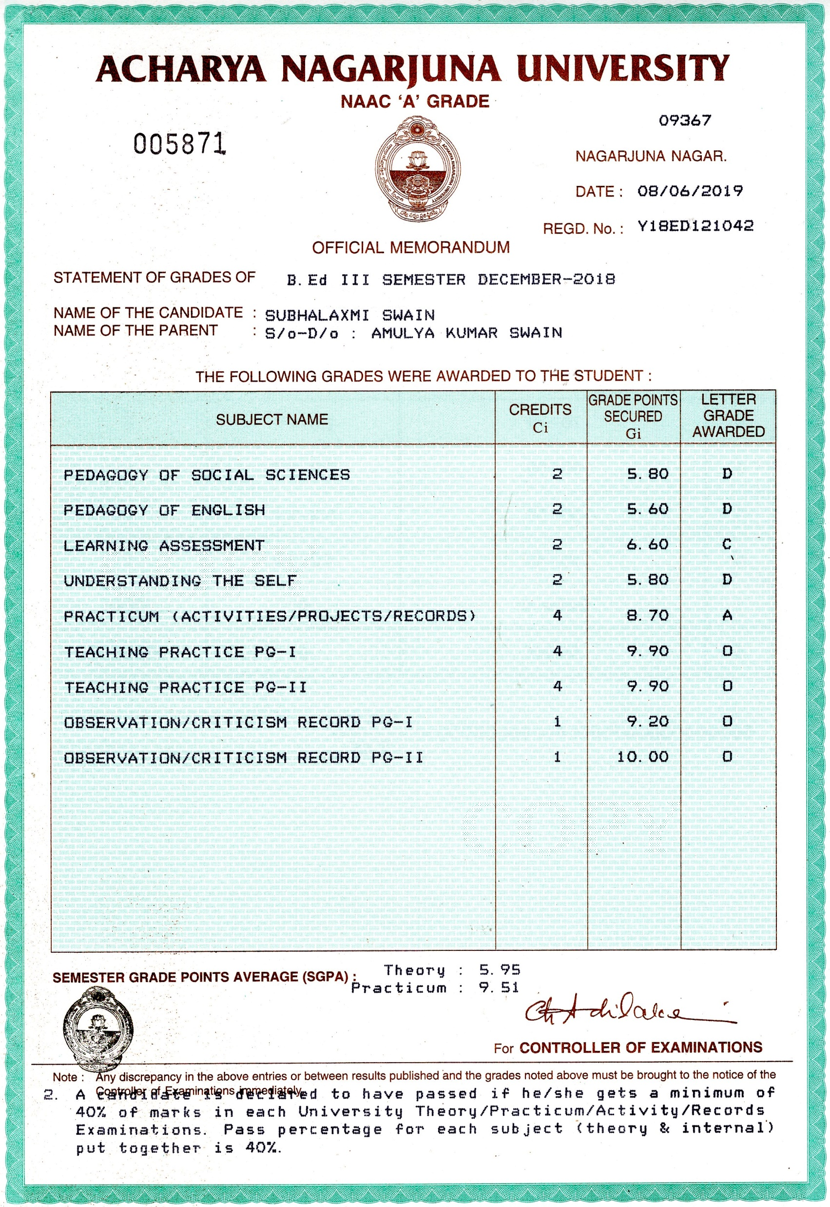
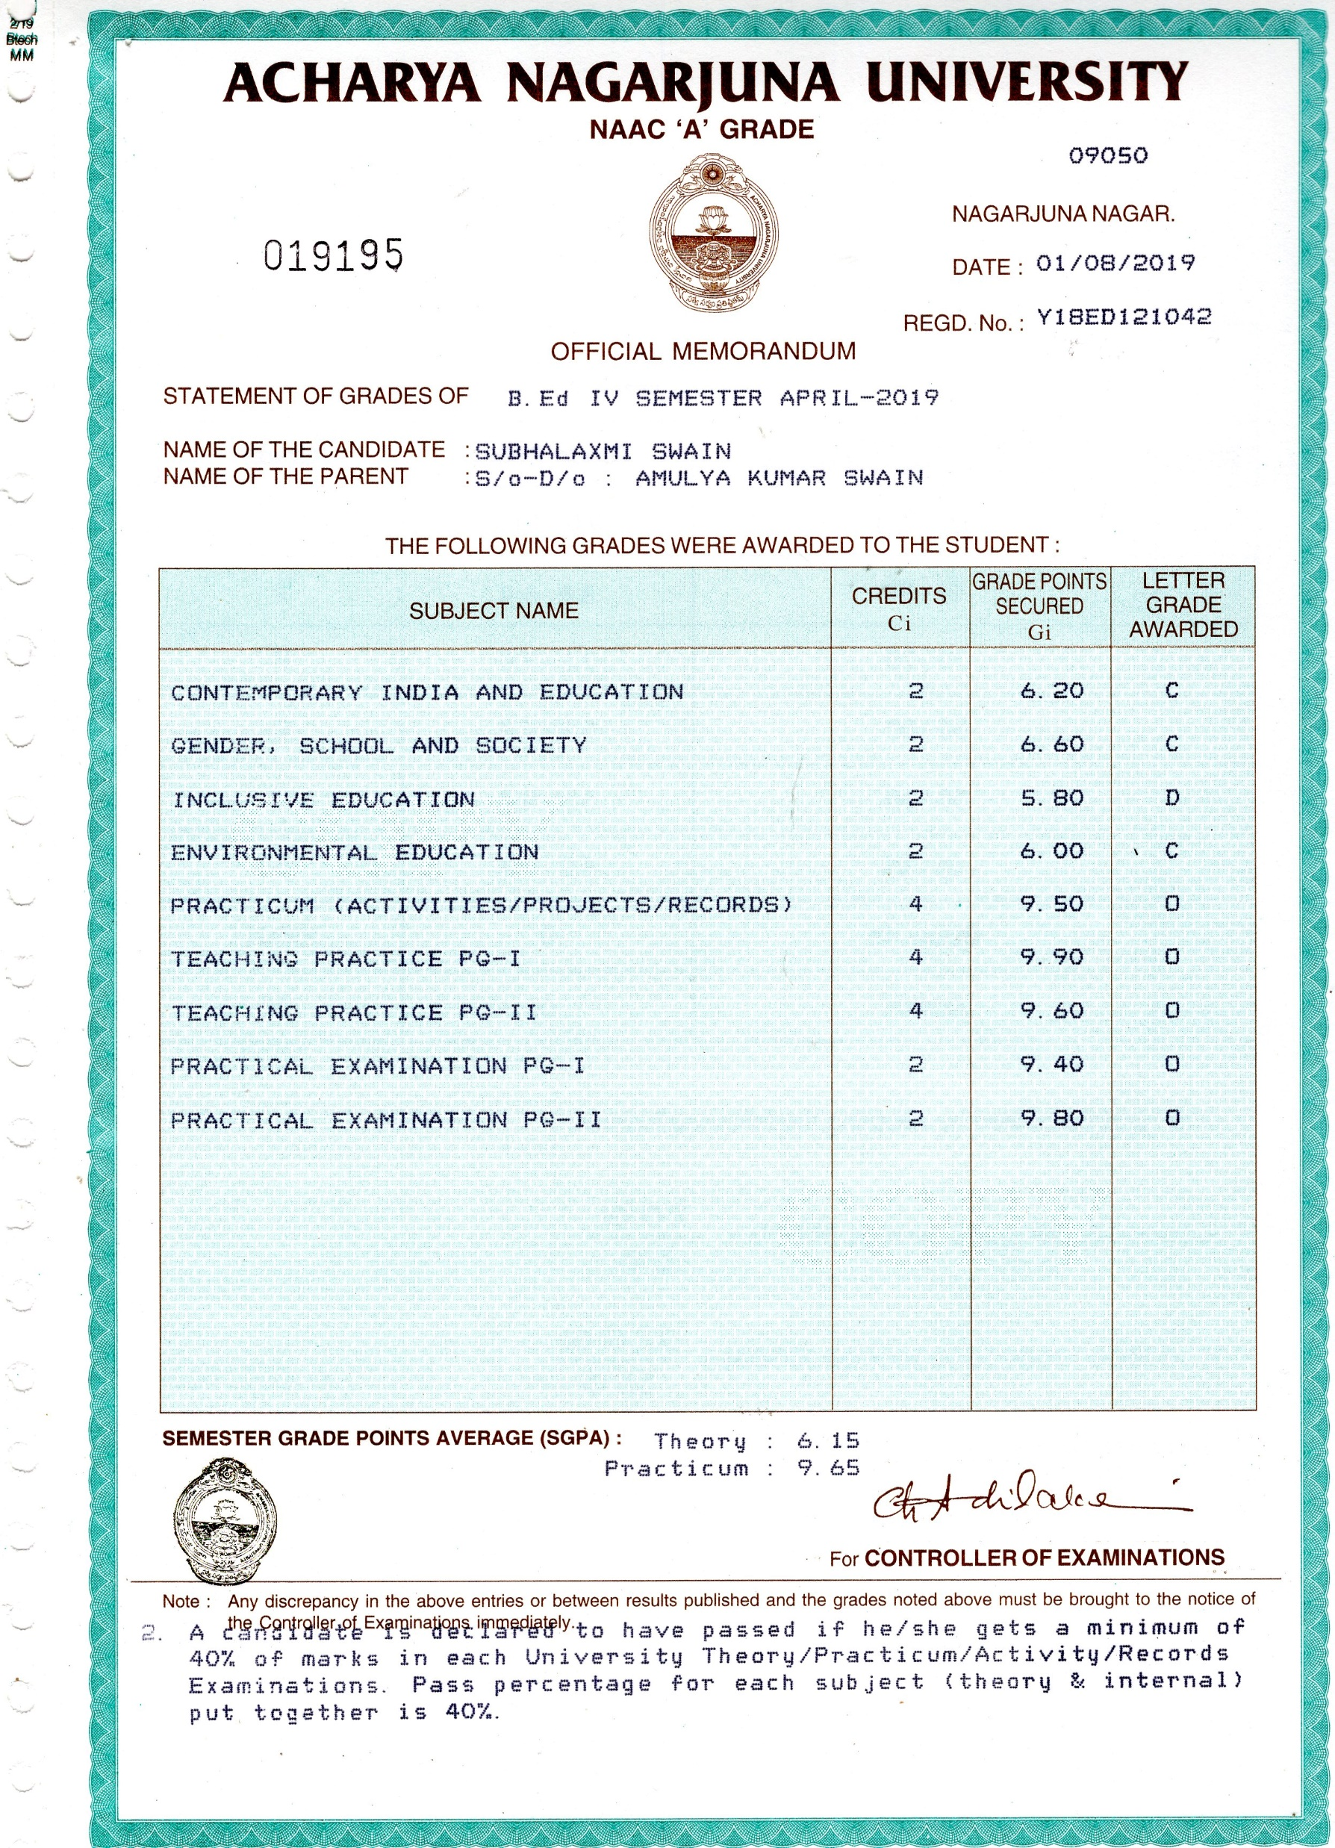
3rd and 4th Semester B.E d Marksheets

Slide 11
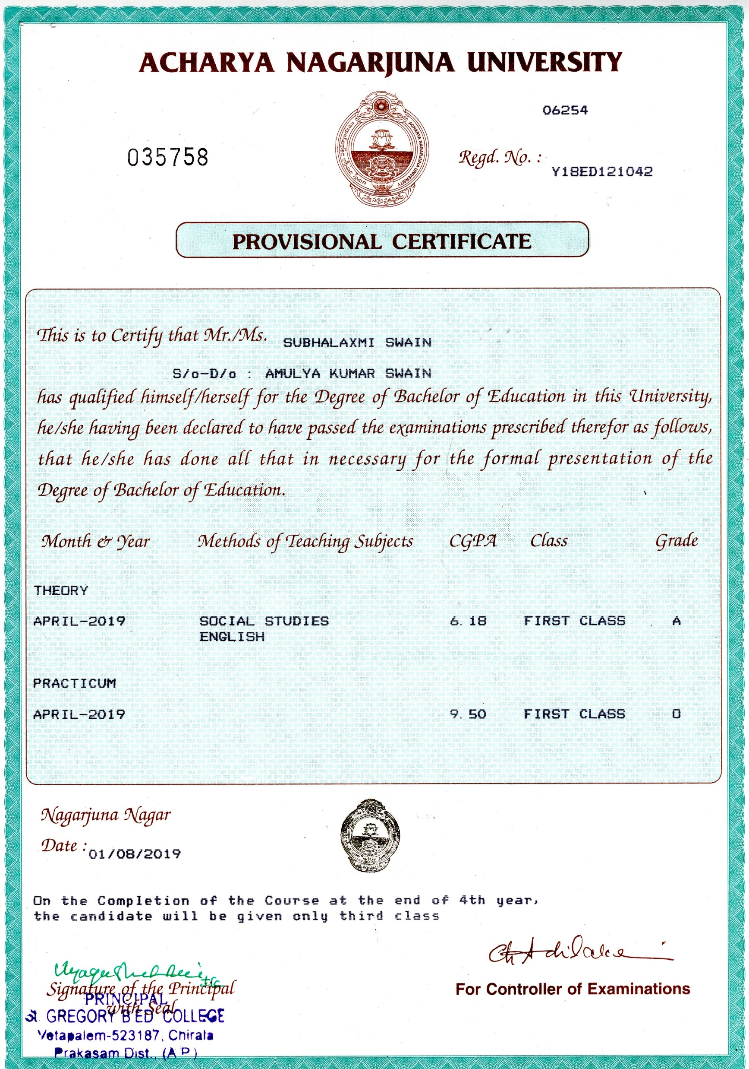
B.E d Provisional Certificate

