Slide 1
B.TECH/B.E (AMIIE)
BTECH course is under INDIAN INSTITUTE OF ENGINIEERS (IIE) NEW DELHI.
Under Govt. of India (MHRD), Courses as per AICTE norms.

Slide 2
ELIGIBILITY: Diploma Polytechnic
DURATION OF COURSE : 3YEARS (SEMESTER SYSYTEM)

Slide 3
For Course Detail , pl. visit the link below
https://www.iieinstitution.com/CourseEng.aspx

Slide 4
APPROVALS & RECOGNIZATION
For approval & recognization pl. visit the below link
https://www.iieinstitution.com/approval_and_recognition.aspx#go

Slide 5
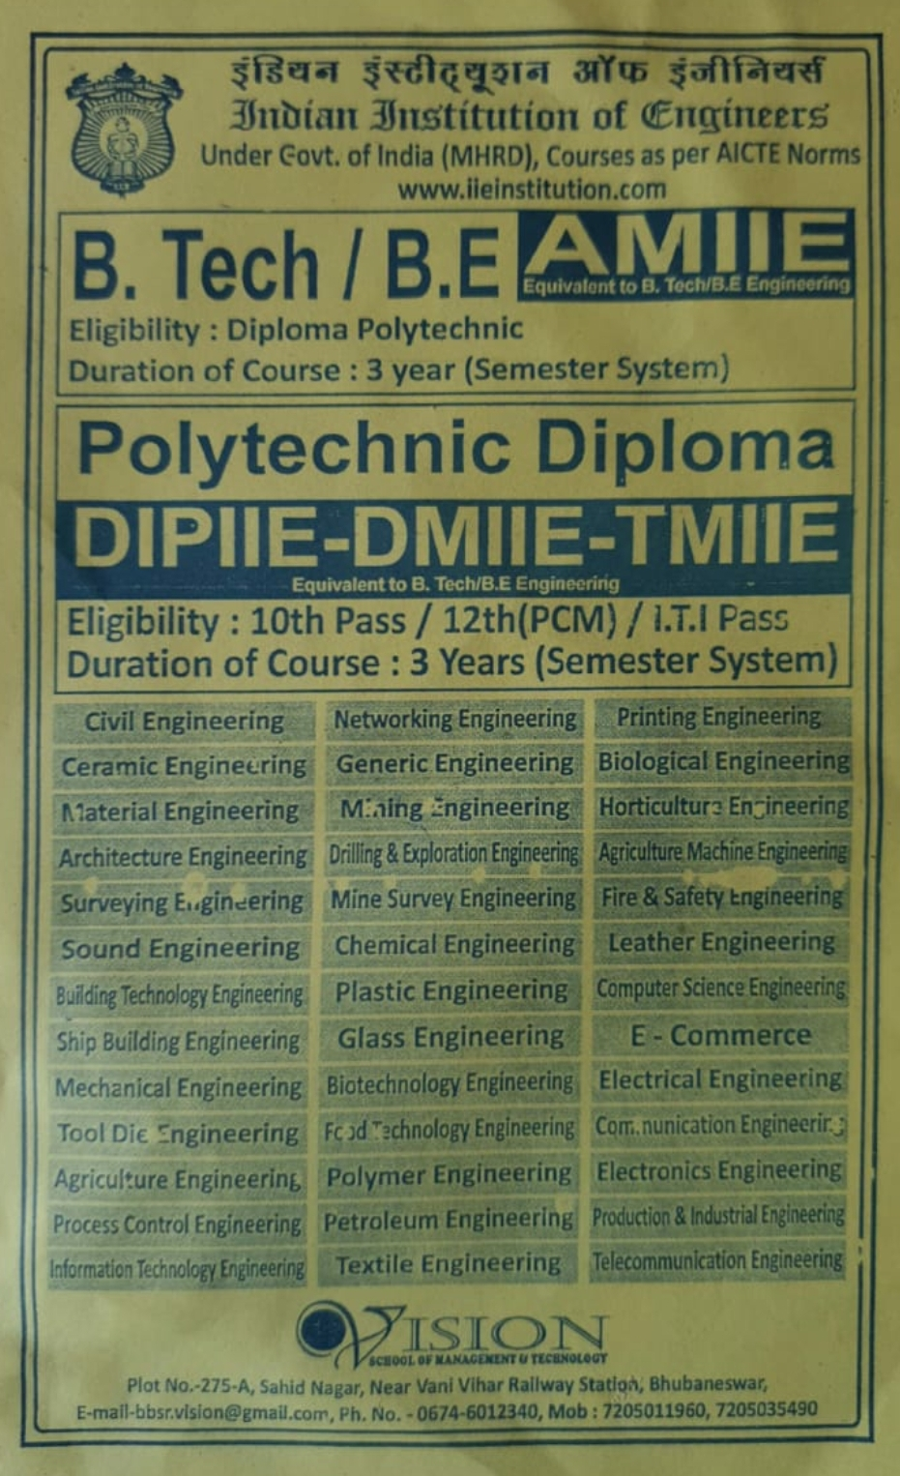
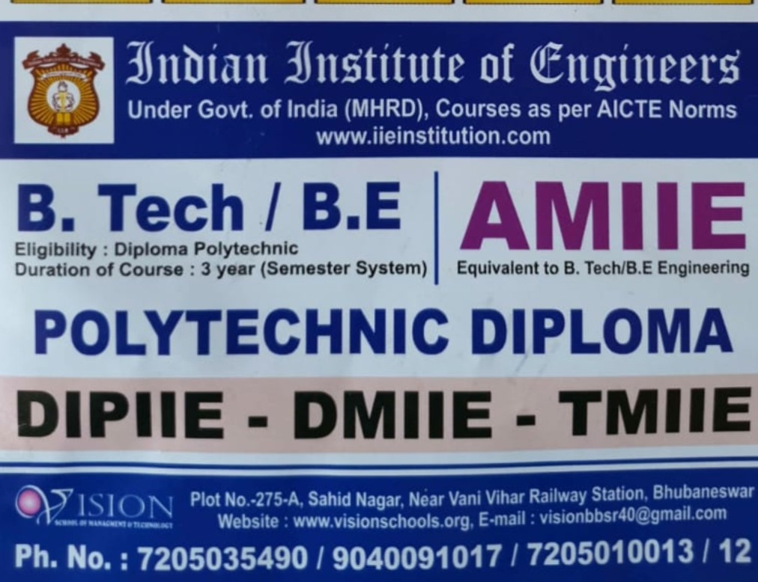
COURSES OFFERED UNDER IIE

Slide 6
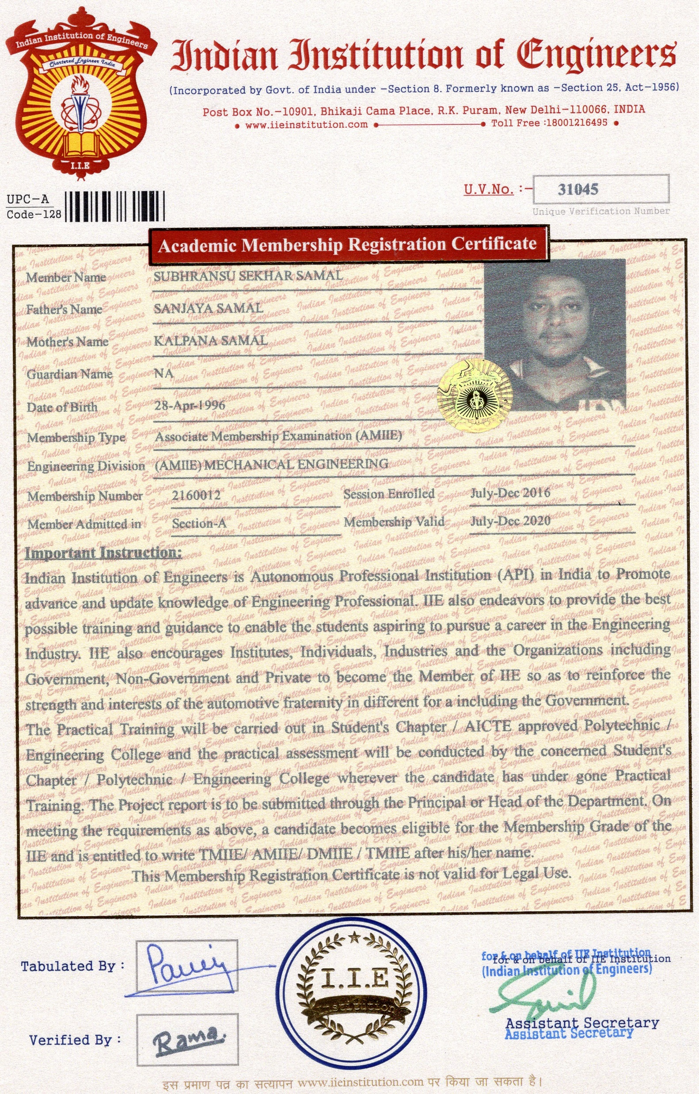
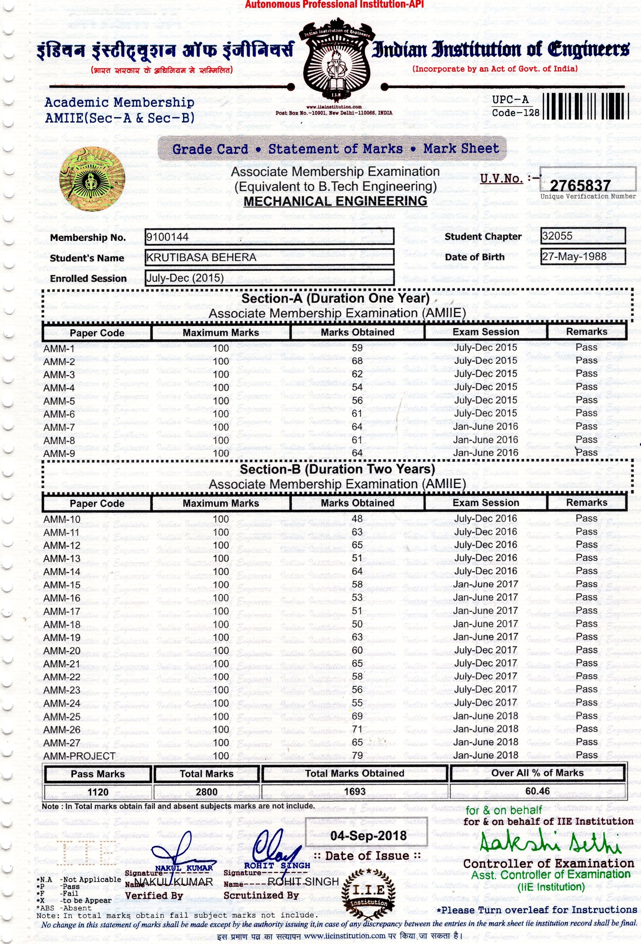
Registration Certificate & Marksheet

Slide 7
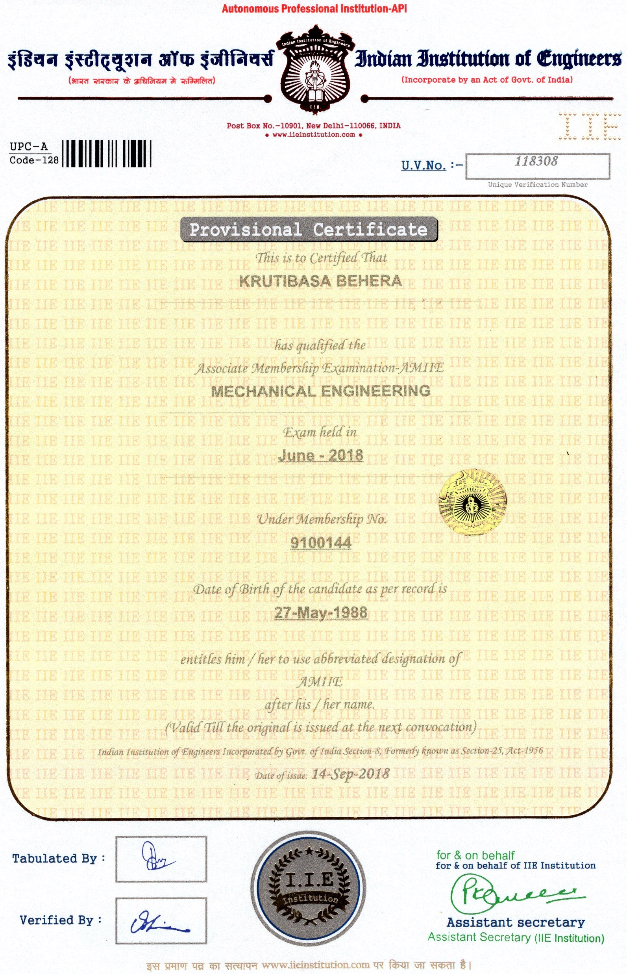
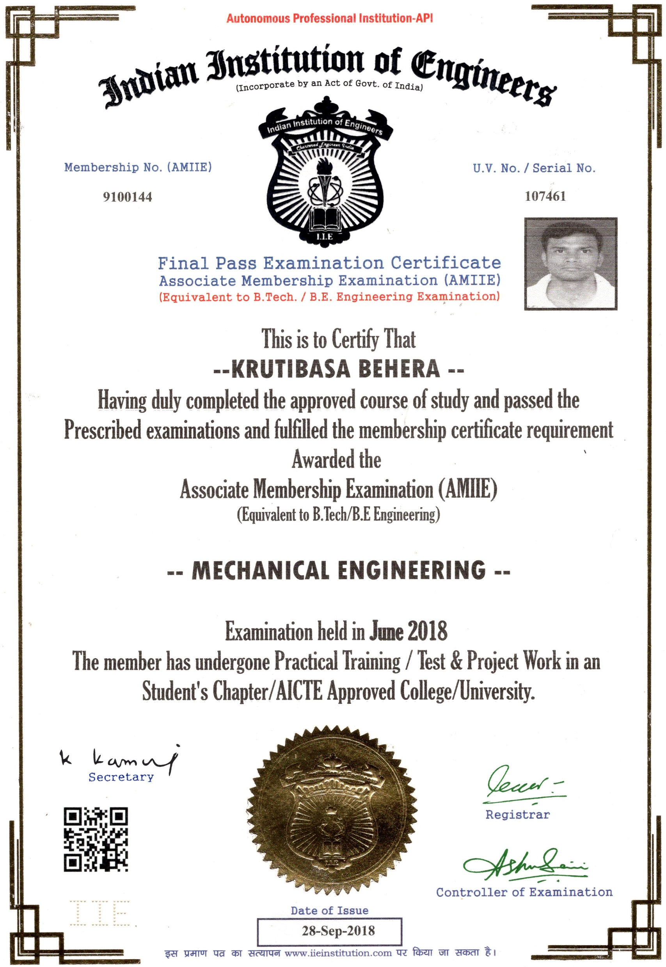
PROVISIONAL & MAIN CERTIFICATE

